Slide 1





Sparks
Insights – Finding potential clients from external data
Zichao Wang Xuan Han Xiaotong Li Hanchen Huang
Date: 2016 – 11 – 27

Slide 2
Starr Sprint: Scope of Work (SOW)
Developing a “direct to consumer” business model with brokers
Internal data mining to classify high risk/low risk business
Identify potential clients (using external data)
How can external data improve underwriting?

Slide 3

How is our team’s work related to Starr’s SOW?
Found nationwide external data sources that match the characteristics of low-risk policies and utilized external data in marketing on potential low-risk business or profitable business in order to increase sales.
Results provided us insights on determining High-Risk policies in order to optimize underwriting process and quotation process for the Starr Company.
Low-Risk Policies: More profitable
High-Risk Policies: Less profitable

Slide 4

What We Have Found? Insights from our Team
Combined Loss Ratio (Loss, Expenses and Recoverable)
of each U.S. States
High and Low Risk business analysis on coverage information, business types based on suggested U.S. States
Top Three suggested U.S. States: Alabama, California and Louisiana
Total of 20637 low risk businesses from top three suggested states. (Data obtained from Manta)
Total premium per policy

Slide 5

Our Team’s Solving Approach
Loss Analysis on all active Starr policies
Cluster Analysis – Focus on identifying features of High/Low Risk business
External Data Sources Analysis – Focus on optimizing current underwriting process
Web Scraping(Cluster and External Data combined) – Focus on filtering suitable active low risk businesses from various resourceful websites

Slide 6
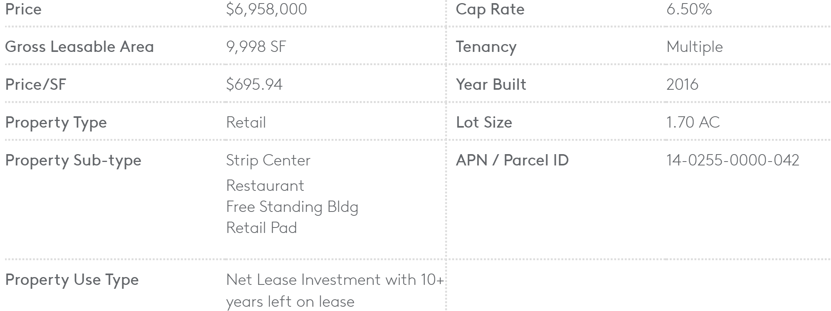
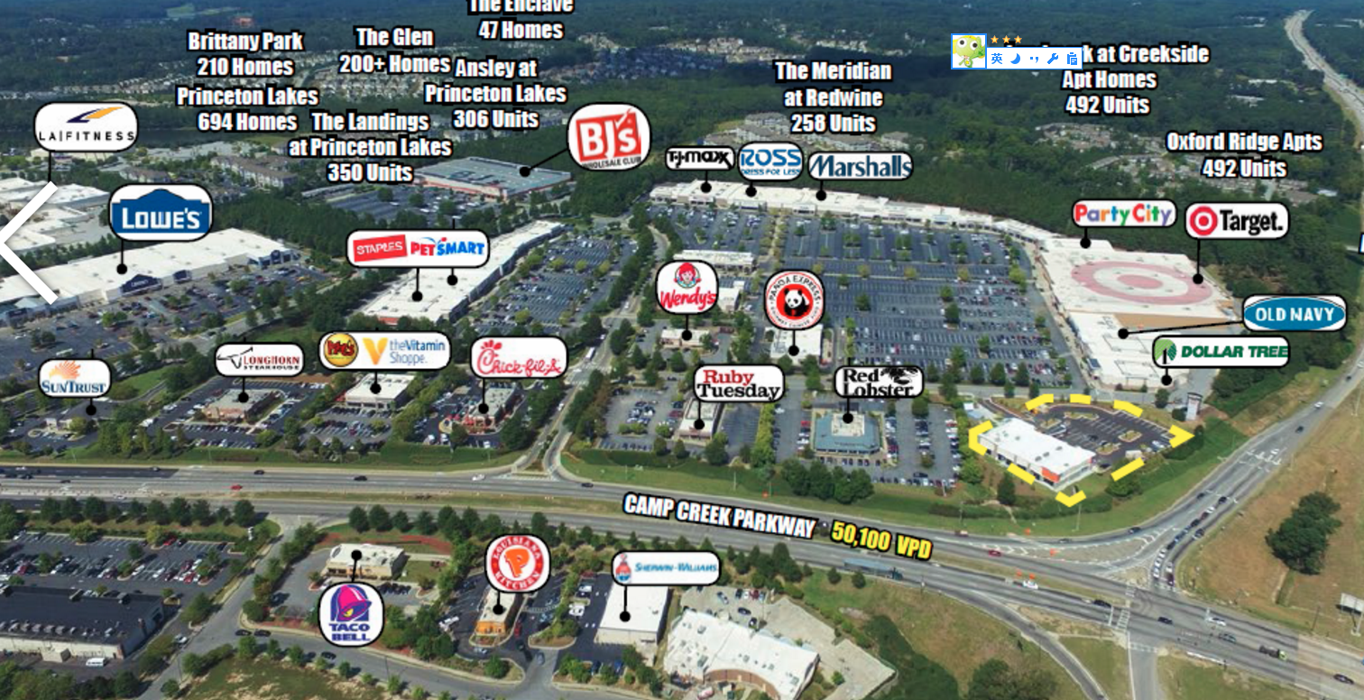
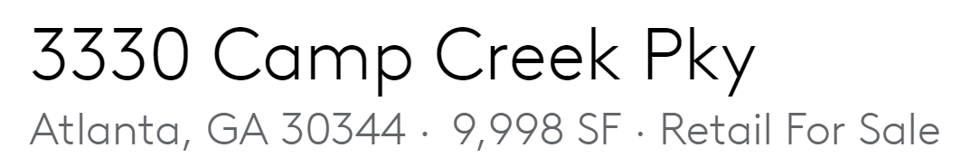
Commercial Property Resource
√ PUBLIC
√ FREE
Commercial: www.loopnet.com
Loopnet is the website that designed for commercial property listing. When a commercial building address is entered, loopnet will return basic info such as price, building year, building type, construction type of the property. Some properties will also display surrounding business types. That information could work as key factors when evaluation potential client.

Slide 7

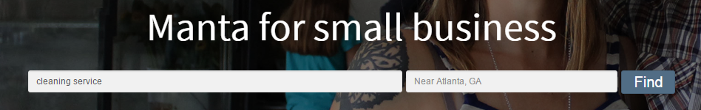
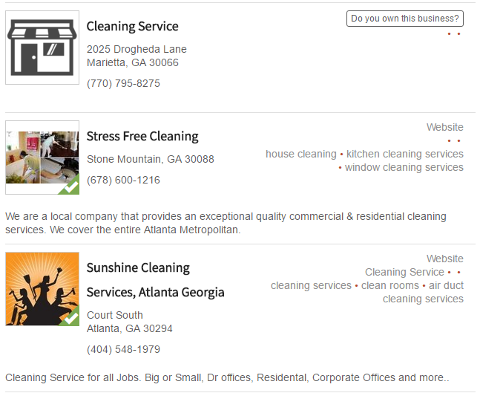
Commercial External Data Source
Commercial: www.manta.com
National wide small business service directory and search engine provides small businesses with networking information. It sponsors and involved small business events/trade shows across U.S.
Pros: Detailed Business Classification matches Starr’s ISO Class Code (Information is available for purchase)
Cons: No API Available

Slide 8
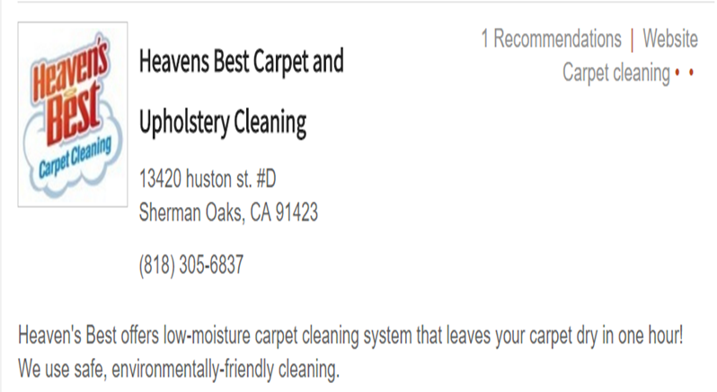
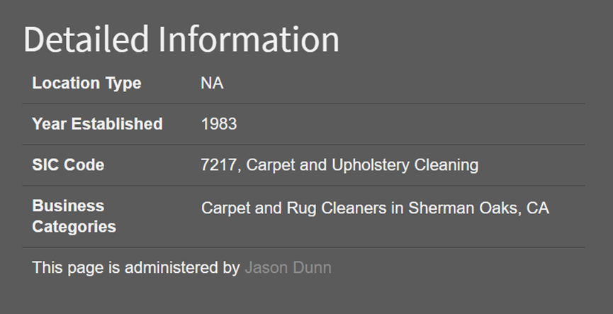
Commercial External Source Continue

Slide 9
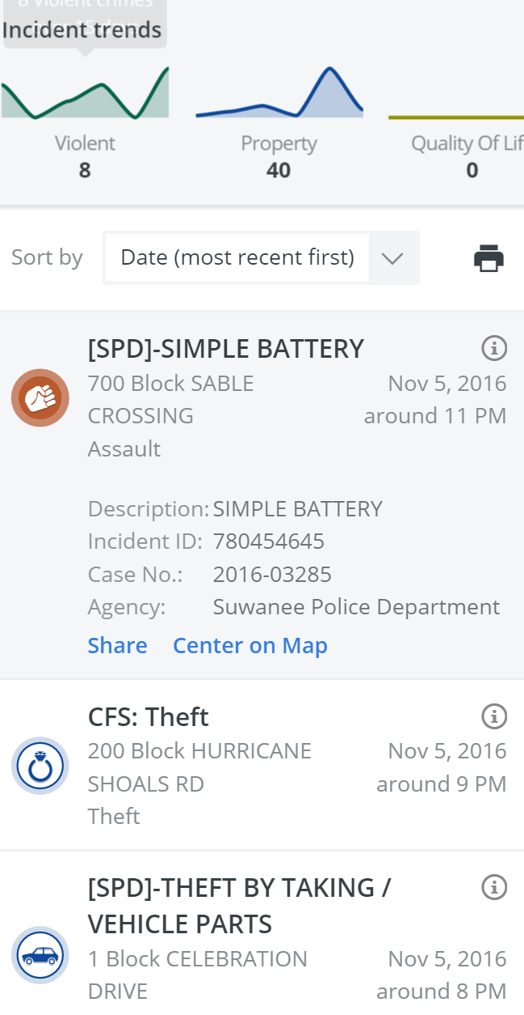
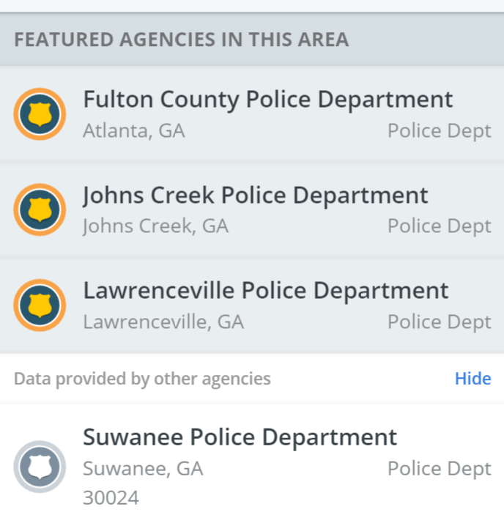
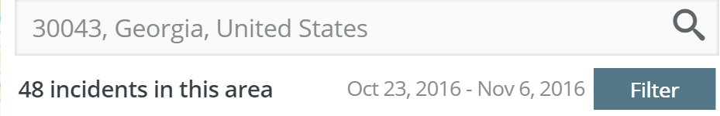
Other External Data Source
√ API
√ PUBLIC
√ FREE
Crime: www.crimereports.com
This website provides basic crime statistic based on state, zip code or address. Agent/Underwriter can use this website to check on the overall crime rating of a specified location.

Slide 10
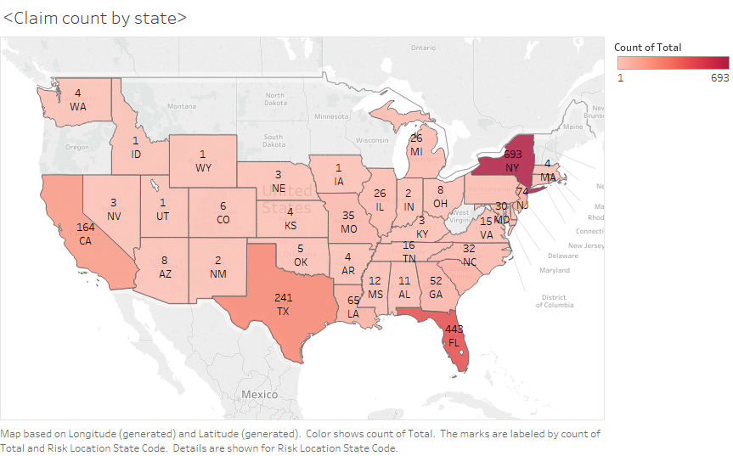
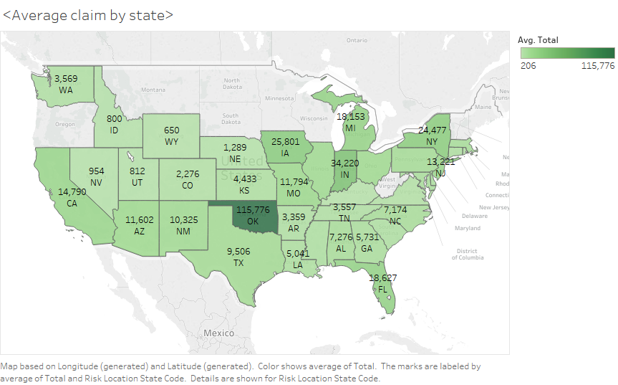
Starr Claim Analysis
Claim Count by States
Average Claim Loss Amount by States

Slide 11
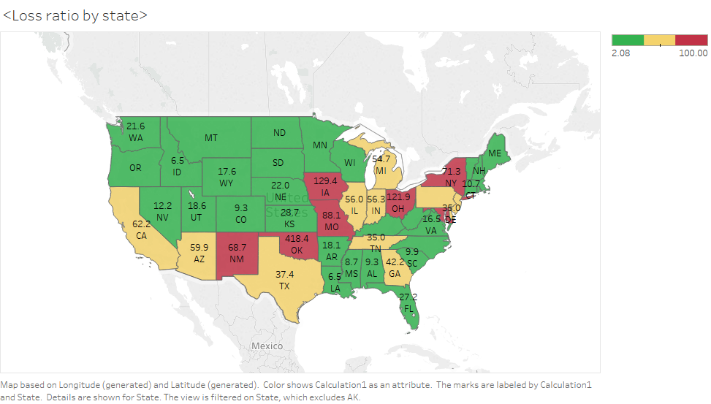
Combined Loss Ratio Distribution by State

Slide 12
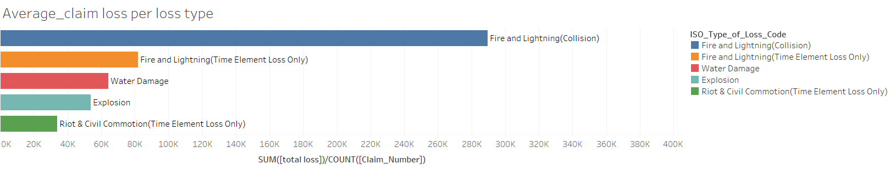
Average Claim Loss Per Loss Type

Slide 13
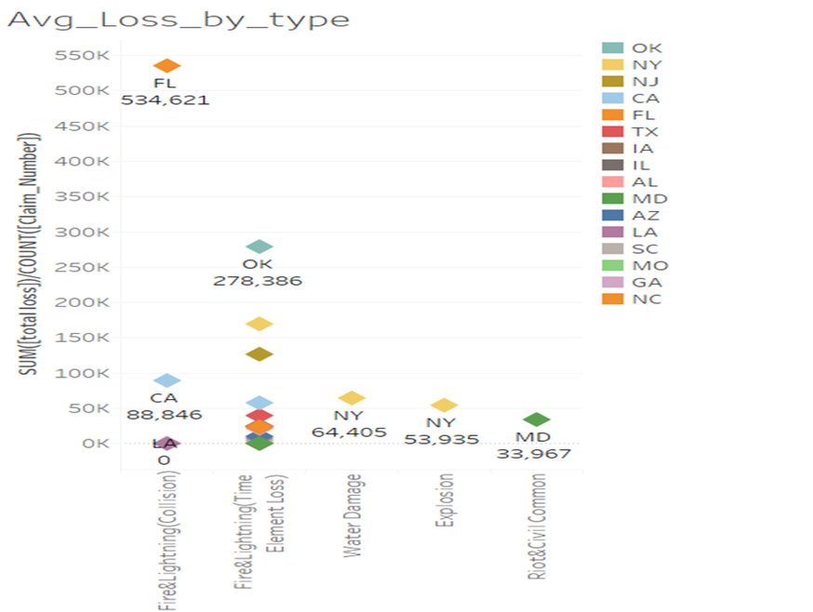
Average Loss Amount from Top 5 Loss Type

Slide 14
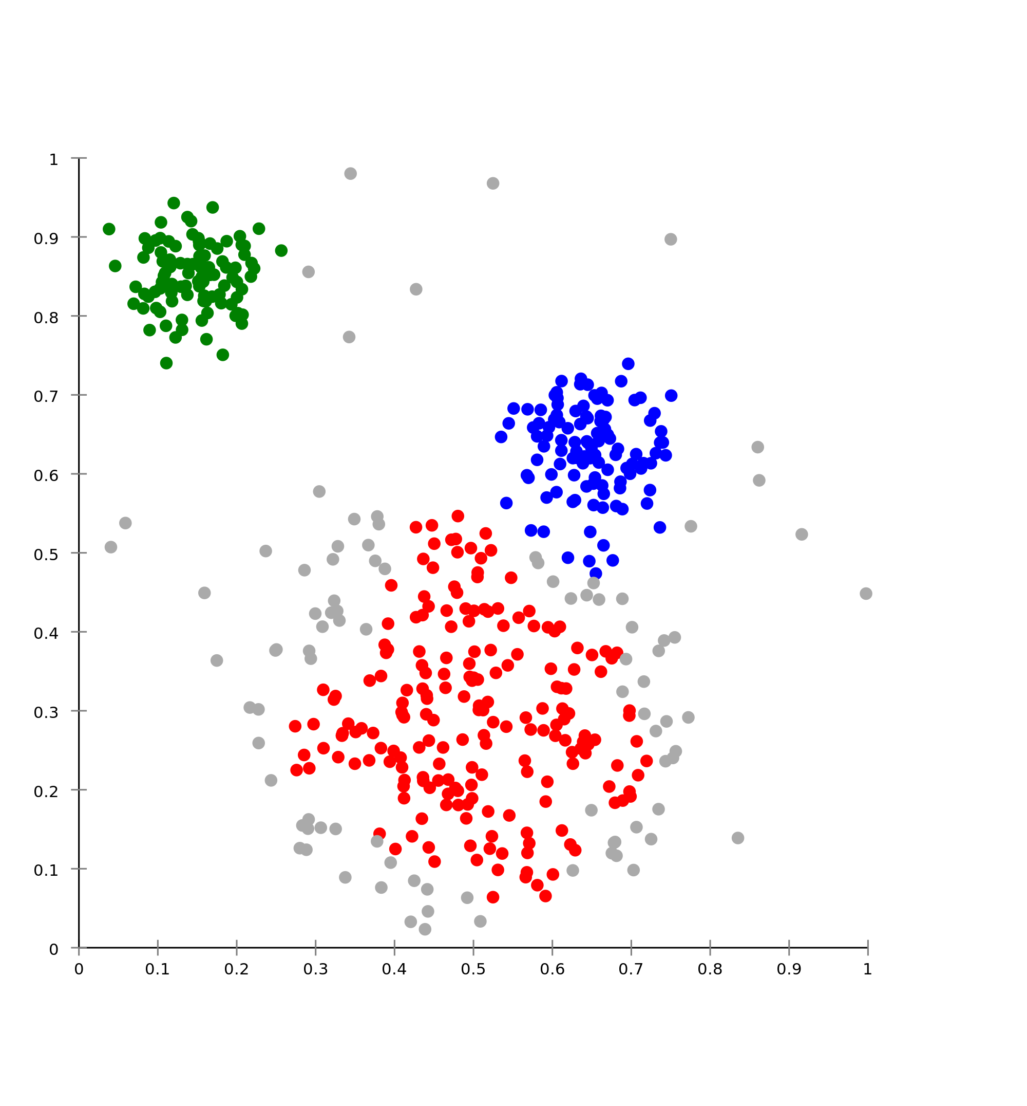
Cluster Technique Approach
Cluster Analysis Diagram Example
Purpose: Identifying and grouping features associated for both High and low Risk business
Combined Loss Ratio: (Expenses + Loss + Recoverable)/Total premium per policy
High Risk Clients: Combined Loss Ratio > 1
Low Risk Clients: Combined Loss Ratio < 0.42 (Average)

Slide 15
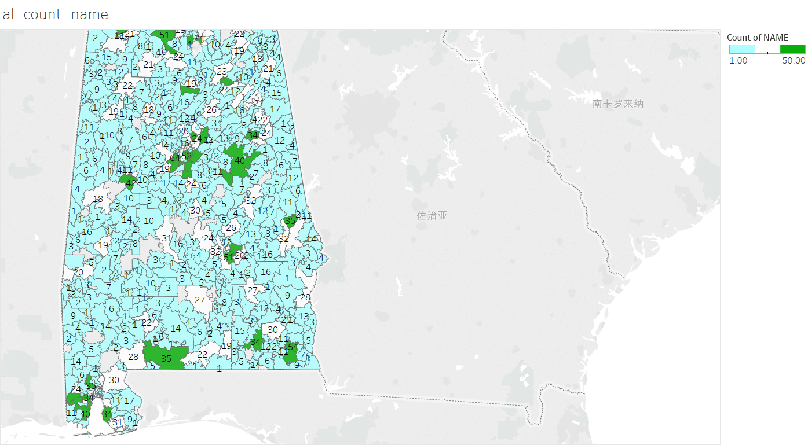
Alabama Potential Low-Risk Business
Total suggested potential Low Risk Business in Alabama: 6476
Alabama
Low Risk | Office - Veterinarians Office - Office
 | Contractors - Carpet, Rug, Furniture, or Upholstery Cleaning - On customer's premises - Shop
 | Grocery - Stores - With an area at least 4,000 square feet - Without Gasoline Sales
High Risk | Clothing or Wearing Apparel - Retail - Clothing - Men and Boys' (Coats and Suits)
 | Engraving
 | Appliance - Stores Radio, Television, and Phonographic Stores (including parts and supplies)
 | Office - Medical Offices - Office
The map is populated based on data extracted from Manta.com, each number on the heat-map indicates sum of suggested potential low risk business of that zip region.

Slide 16
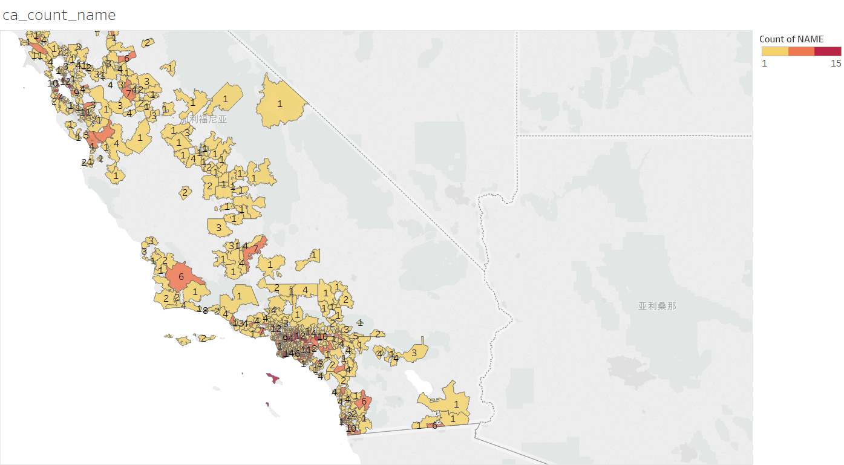
California Potential Low-Risk Business
Total suggested potential Low Risk Business in California: 3074
California
Low Risk | Meat, Fish, Poultry or Seafood - Distributors
 | Plumbing Contractor
High Risk | Electronics Stores
 | Cosmetic, Hair or Skin Preparation - Retail Only
 | Laundromat (Self-service) - Supervised
 | Convenience Food Stores - Without Gasoline Sales - No Restaurant
 | Electrical Lighting Stores
The map is populated based on data extracted from Manta.com, each number on the heat-map indicates sum of suggested potential low risk business of that zip region.

Slide 17
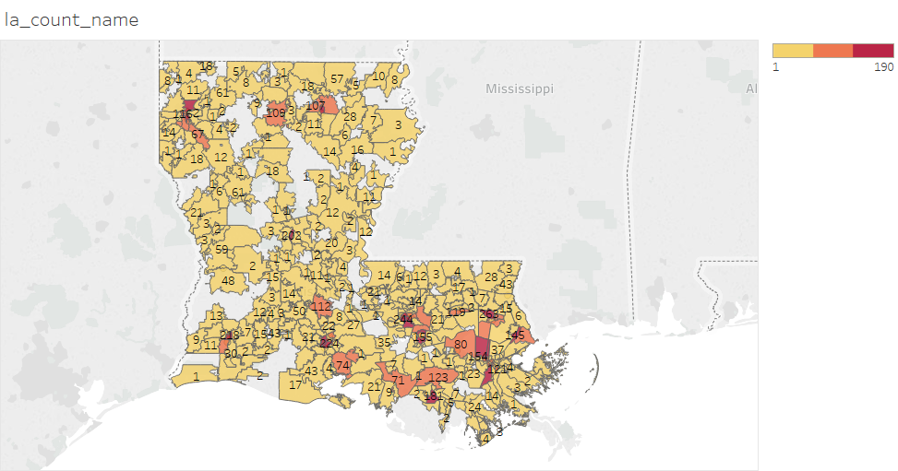
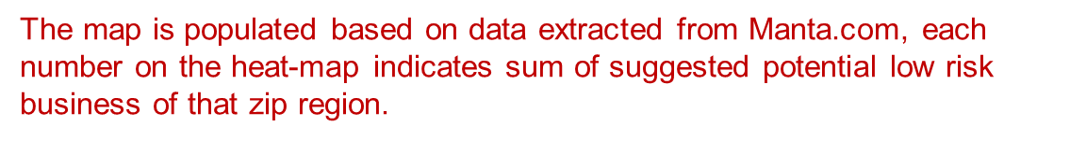
Louisiana Potential Low-Risk Business
Total suggested potential Low Risk Business in Louisiana: 11086
Louisiana
Low Risk | Office - Medical Offices - Office
 | Clothing or Wearing Apparel - Retail - Clothing - Ladies' and Girls'
 | Photographer
High Risk | Bakeries - Retail - With baking on premises
 | Appliance - Stores Radio, Television and Phonographic Stores
 | Contractors - Heating or Combined Heating and Air Conditioning
 | Contractors - Interior Decorators - Shop
 | Antique Stores
 | Laundry and Dry Cleaning - Laundry and Dry Cleaning or Dyeing

Slide 18

Suggested Potential Low-Risk Businesses
TYPE | NAME | STREET | CITY | STATE | ZIP | CONTACT.INFO
Videographers | Dreams Images In Photog | 402 Lei Lani Avenue | Abita Springs | LA | 70420 | (985) 809-9178
Women's Clothing Stores | Branch Out | 2022 Magazine St | New Orleans | LA | 70130 | (504) 371-5913
Women's Clothing Stores | Joy Fashion | 9954 Lake Forest Boulevard # 9 | New Orleans | LA | 70127 | (504) 244-0757
Wholesale Meat | Hammons Meat Sales | 120 Old Yard Drive | Bakersfield | CA | 93307 | (661) 831-9541
Wholesale Meat | Los 3 Amigos | 5912 Cedar Glen Lane | Bakersfield | CA | 93313 | (661) 836-3616
Veterinarians | Korsch Jana DVM | 3783 Pine Lane Se | Bessemer | AL | 35022 | (205) 578-1509
Veterinarians | Kasten Avery DVM | 3763 Pine Lane Se | Bessemer | AL | 35022 | (205) 578-1512
Results contains all potential Low-Risk Businesses from three suggested states. Each row contains the following information: Business Type, Name of Business, Business Address, and Contact Info. (The complete business list is available in excel format)

